Slide 1
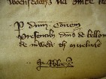
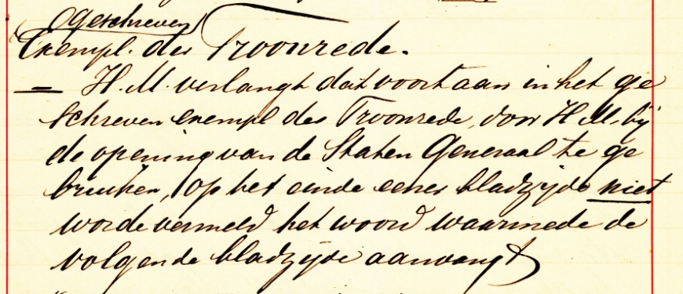
Handwriting Recognition
A comprehensive course with practical assignments
Lambert Schomaker

Slide 2
Overview - 2021
Teachers:
Prof. Lambert Schomaker
Instructor: Maruf Dhali + Tas Student Assistants: Peter Verga Tobias van der Werff Jeroen Muller
Goal
What is handwriting recognition?
Course setup

Slide 3
Goals of the course
Challenge you on several levels:
Learn a scientific approach to PatRec,ML,DL;
Develop your skills
in programming for AI
in empirical evaluation of systems
in team work
in scientific reporting (oral/written)
Content area: the elusive problem of computer-based handwriting recognition

Slide 4
What is handwriting recognition?
The automatic translation from written shapes into letter codes

Slide 5
What is handwriting recognition?
The automatic translation from written shapes into letter codes
letter codes: ASCII and Unicode,
which can be used by the computer for
processing (editing, search)

Slide 6
What is handwriting recognition?
The automatic translation from written shapes into letter codes
What are written shapes?

Slide 7
What are written shapes?
On-Line Recognition: temporal data, the input consists of a sequence of x,y coordinates (a vectorial representation) of the pen-tip movement
A digitizer tablet is used for recording
Off-line Recognition: static data, the input consists of an image of script (a pixel representation).
A scanner is user for recording the script
Often named ‘OCR’: optical character recognition (but in handwriting not always character based!)

Slide 8
What are written shapes?
On-Line Recognition: x_{t},y_{t}, and z_{t} or p_{t}
Off-line Recognition: I(x,y) where the image is Black/white: 1 bit/pixel Grey: 8bits/pixel ➔ lately: 16bits/pixel Color: 3x 8bits/pixel (rgb) ➔ lately: 3x 10bits/pixel

Slide 9
Other ‘AI’ task in handwriting recognition
Word spotting (given a word image, spot similar words in a huge collection of scanned image)
Given a line-strip image, give the sequence of letters
Who wrote this?
When was this manuscript written?
In what language is this written?
In what major script is this written?
To what style group (‘font’) does this sample belong?

Slide 10
Course setup 2022
Lectures + student team reports
Practicals Task 1+2: Dead Sea Scrolls – character segmentation and classification
Task 3: Multi-writer contemporary handwriting data set (IAM) – line-strip image text recognition (‘HTR’)

Slide 11
Teams
There are about 90 students
Step 1: inventory of student skills (Maruf, webform)
Step 2: we propose teams to cover all needed skills:
1 Programming (softw. eng., overall architecture)
2 Statistics, empirical evaluation (‘R’, Matlab)
3 Computer Vision / Signal Processing
4 Machine Learning
5 Text redaction (‘Editor’), scientific aspects

Slide 12
Rules
Each team member needs to be able to run the team’s system (not a single programmer and a group of freeloaders): share the code and learn about installation problems
The final report is a joint effort, but NOT for the Discussion section which is personal. Explicit footnotes required: ‘Who did what?’ in the team

Slide 13
Today: fill in the ‘skills’ web form
General pattern of lecture time slots:
1st hour: Lecture (by me)
2nd hour: Team reports (not today)
Tasks:
Give each other feedback on oral team reports in break-out sessions
Final report: Write your own,
Evaluate two other reports
(final grading by teacher)

Slide 14
Questions on the process?
Next week
Be sure you are a member of a team
Also use the time to get into the literature
(refs will be given in the practicals)

Slide 15
Practicalities
One Peregrine account per team, max
You need to understand what is going on in the code

Slide 16
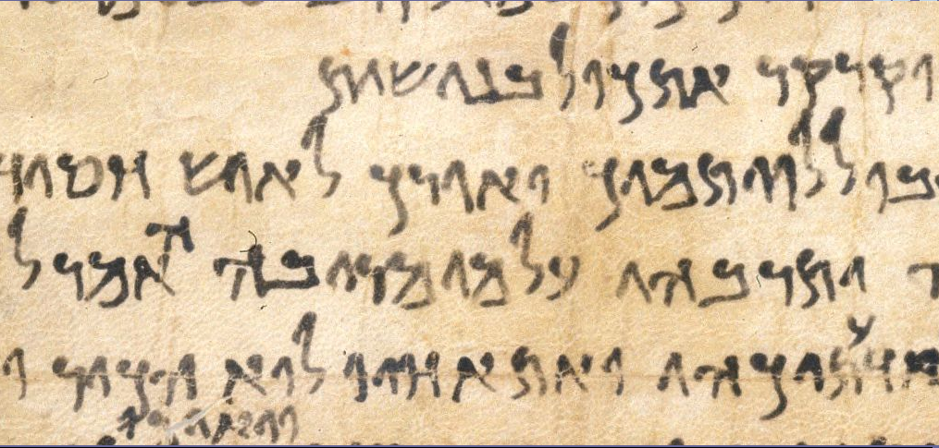
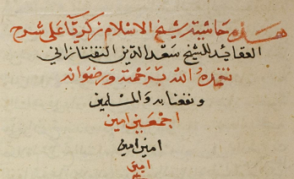
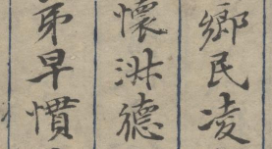
Large-scale processing of handwritten historical documents: The Monk sysem
Lambert Schomaker
ERC project Qumran/Popovic (12-4-2015, Jerusalem)
Academie der Wissenschaften, Mainz, April 2016

Slide 17
Monk e-Science web service addressing these questions:
What? Word retrieval by 24/7 machine learning
Ambition: A European Google for handwriting
When? Medieval manuscript dating Where? Geographical localization
Goal: uploading of charters from 1300-1550 on a server
Who? Writer identification
On Monk server over internet
Using GIWIS Windows tool

Slide 18
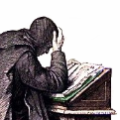



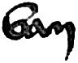

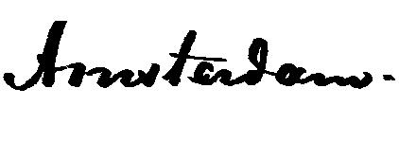

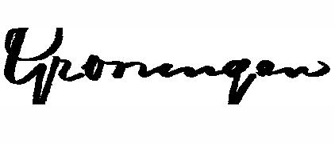


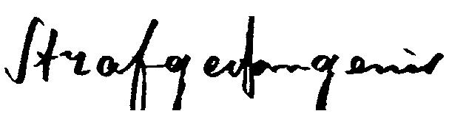

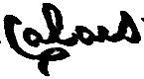

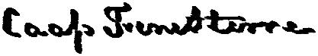
Monk
What?

Slide 19
When? Medieval Paleographical Scale (MPS) with prof. Jan Burgers (paleographer, Huygens Inst.)
PhD student Sheng He
1400
1450
1500
1550
1600
year →
Reference documents
Sub styles, geographical regions
Find year
?

Slide 20
When? Qumran ERC project with Mladen Popovic
Dual-mode time axis estimation (PhD: Maruf Dhali)
C₁₄ estimates
Date & ‘hand’ knowledge
400BCE
350BCE
300BCE
250BCE
200BCE
Reference documents
AnnotationTitle Year
Hand
Region
Paper type
Pen type
Image ROI
C14 estimate
Shape evidence, pattern recognition
Find nearest neighbour
?

Slide 21
Where? Medieval Paleographical Scale (MPS) with prof. Jan Burgers (paleographer, Huygens Inst.)
1400
1450
1500
1550
1600
year →
Reference documents
Sub styles, geographical regions
Find city
?

Slide 22
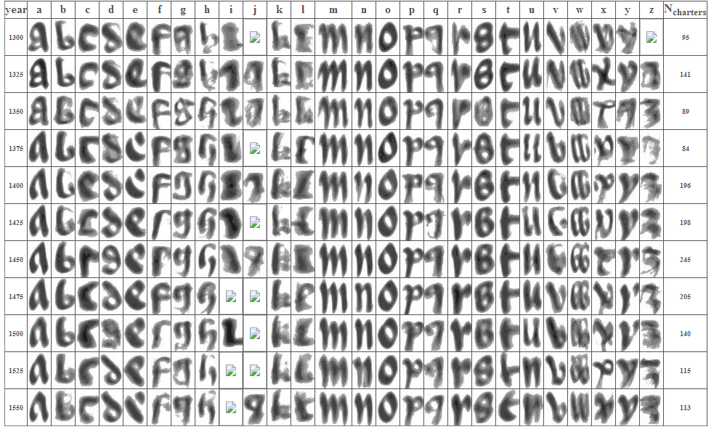
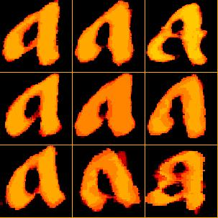
Medieval Paleographic Scale (under dev.)

Slide 23
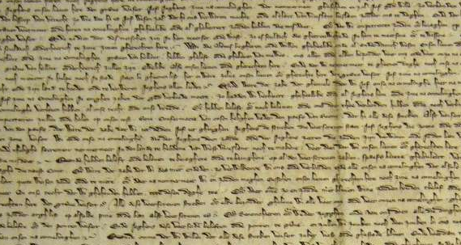
Writer identification (1:N)
and verification (1:1)
1. Interactive,
2. Automatic, ROI based
3. OCR based
fully manual
Who?
Region Of Interest

Slide 24
Researchers & Monk
Marius Bulacu, Axel Brink, Katrin Franke
Ralph Niels, Louis Vuurpijl, Jean-Paul van Oosten, Sheng He, Jan Burgers, Petros Samara, Olarik Surinta
“The Nijmegen Handwriting Group 1984-1993”
Netherlands Forensic Institute: Ton Broeders, Wil Fagel, Elisa van den Heuvel
Isabelle Guyon, Rejean Plamondon
2016: Maruf Dhali, Mahya Ameryan, Sukalpa Chanda
Users (humanities researchers):
Jinna Smit, Mark Aussems, Masahiro Niitsuma, Mladen Popovic, Daniel Stoekl, Jetze Touber, Grace Fong, Elaine Treharne, Dominique Stutzmann, Andreas Weber, Maxim Romanov, many others

Slide 25
Overview
OCR
vs Text retrieval
Monk system: continuous learning
Materials / Collections
Some examples of training
Conclusions

Slide 26
Case: Optical Character Recognition
“The process of segmenting a text image into individual images and classifying each as being a letter in an alphabet”
Impressive results on contemporary printed text in machine fonts: with some linguistic postprocessing results are close to 100%
Solved?
c
h
a
r
a
c
t
e
r

Slide 27
OCR ?
‘OCR’ on historic documents does not work well
On handwritten manuscripts it doesn’t work, at all!
Problems:
image quality
unknown character shapes
unknown statistical language models
However: pattern recognition and machine learning make enormous progress these days!
Which methods? How to apply them?

Slide 28
Current technology: neat text/known language
Why is ‘OCR’, i.e., letter by letter transcription on handwriting so difficult?
Machine print: per character, per font, 8000 training examples are needed, typically
E. Barney-Smith: 200k instances of printed c vs e
Adress reading: reduced lexicon, zip codes etc., help
In linguistic modeling: 20th century newspaper corpora do very little for 15th century acts
Literary text, acts and charters each need their own knowledge models in order for OCR to work

Slide 29
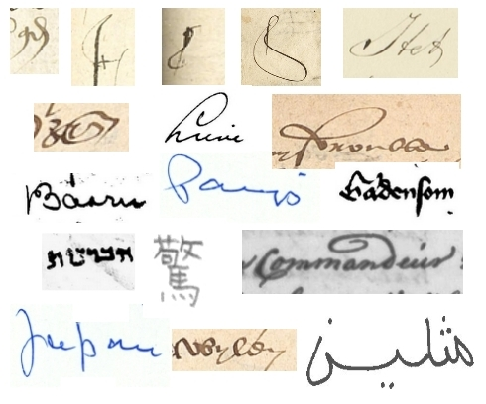
Handwriting recognition: eat this!
Many languages, scripts
Over historical periods
Contractions of letters
‘Suggested’ sloppy letter shapes
Individual writer styles
Image problems
➔ Sliding window for character search usually problematic: exit ‘OCR’

Slide 30
Monk -
Design considerations
Don’t promise perfection
Don’t promise ‘transcription’
Don’t promise exhaustive coverage (as in databases)
Make use of human trainers, volunteers
Word spotting:
“a Google for handwritten documents”

Slide 31
Monk -
Design considerations
Word spotting:
“a Google for handwritten documents”
The word is a reliable chunk of information with many shape features: redundancy minimum
Big Data: With sufficient data, there is always a reasonable response on a query

Slide 32
Monk’s world model:
Institutes
Collections
Books (i.e., documents)
Pages
Paragraphs
Lines
Word zones and characters
Pixels

Slide 33
Functions of Monk from user perspective
Pages (read, annotate)
Lines (read, annotate, search)
Words (cut ROI, labeling, inspect hit lists)
General search functions, ‘google’ over several collections
Human | Machine
Cut out region of interest with the mouse | Segmentation of image into objects
Label a ROI with a text label: | Classify image object
region

Slide 34
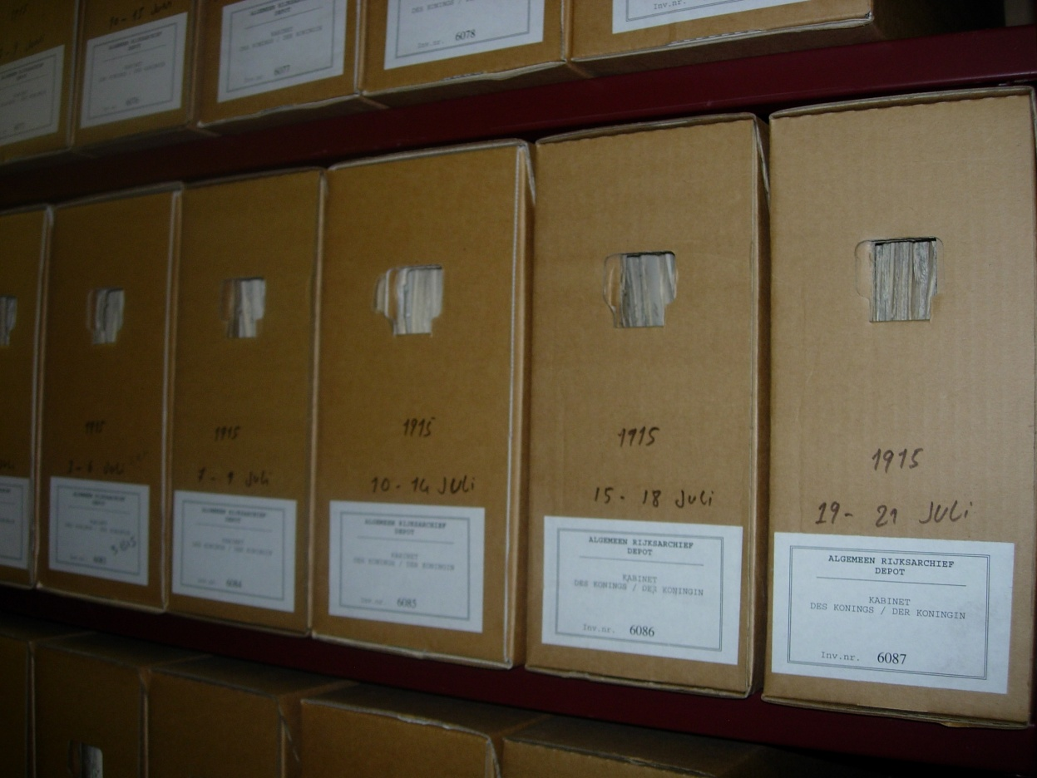
First casus: Cabinet of the Queen (KdK)
all laws, decrees and correspondence are kept:
in a chronological order
and then in a numerical order

Slide 35
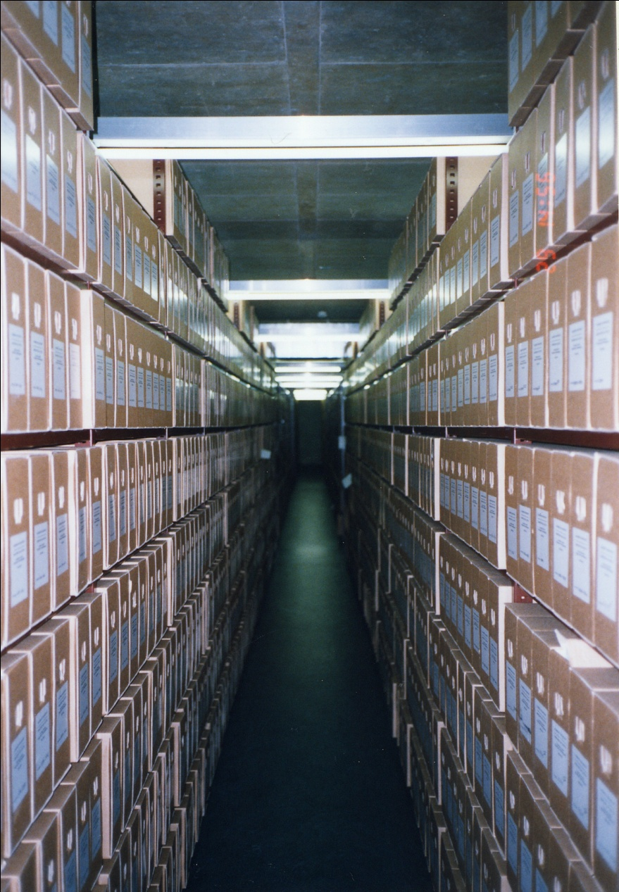
Archival system
KdK Archive with a total extent of
(era 1798-1988):
- 3,250 linear meter of shelves
consisting of:
- 28,000 boxes
average 1,000 pages per box
→ 28,000,000 pages
Of which Monk analyses the handwritten Indices, > 60k pages

Slide 36
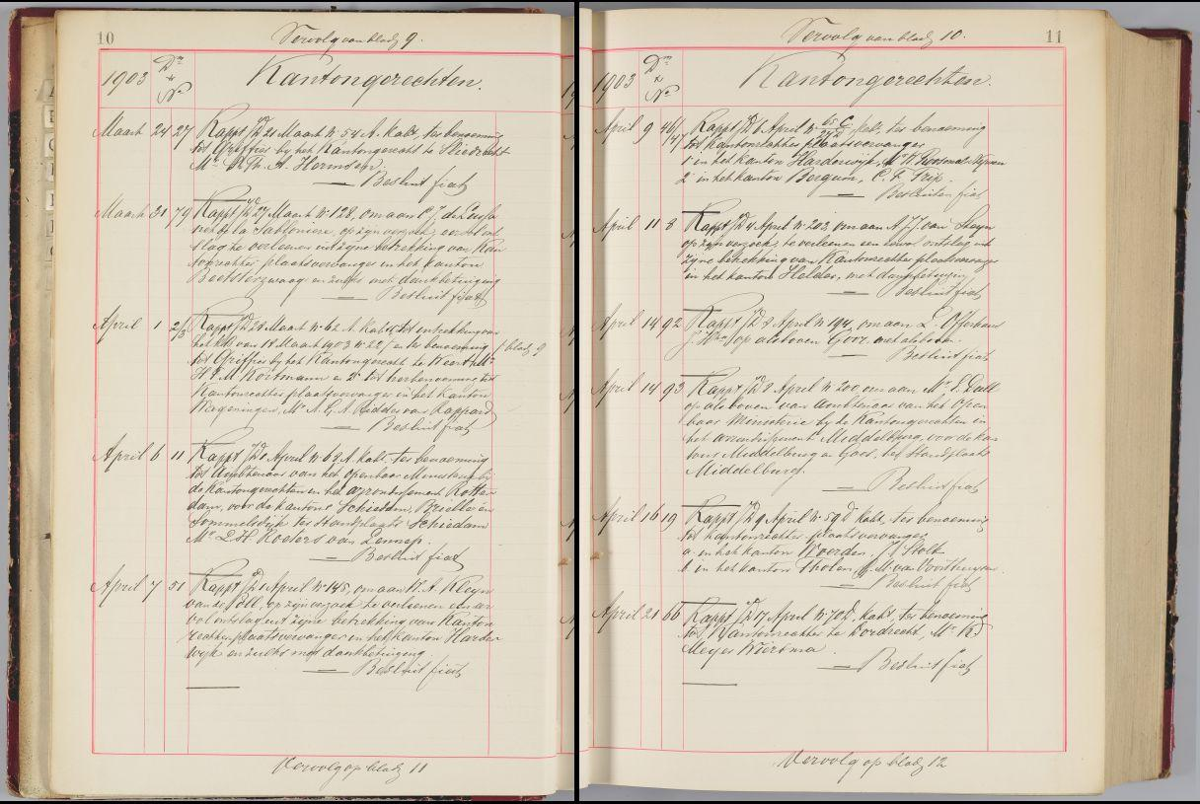
KdK 1903

Slide 37
Coarse overview of current contents Monk, 383 documents, 70k page scans
KdK Dutch administrative 1893-1906 20 books
Dutch Admirality 1760-1823 5 books
Printed, Elzevirium, 1616
Qumran scrolls (2463 scans)
Middelduits (example document)
Accounts, 1425 Gelria
Schepenbank Louvain, 1421-1559, 3 books
Colonial diary (1932)
Municipal year report 1855
20k illuminated initials
Russian handwritten newspaper 1672
Scholarly correspondence 1674-1682
Chronicon Boemorum 1201
Homiliarum Opatovicense 1150
Resoluties Staten Generaal 1627
Medieval charters 1300-1550 in 25yr periods
Witch trial 1605
‘Beowulf’ and related, 4 books
Ming Qing Chinese poetry , 300+ documents
Arabic document, 291 scans
Charlotte Perkins-Stetson diaries 1883- (682p.)
Wittenbergsches (fraktur machine print)
Etc. …
Cooperations with:
Huygens institute, Sorbonne,
Harvard,
Stanford,
Czech National Library,
Dutch National Library, McGill Univ.,
Utrecht Univ.,
Univ. Uppsala
City archive Louvain,

Slide 38
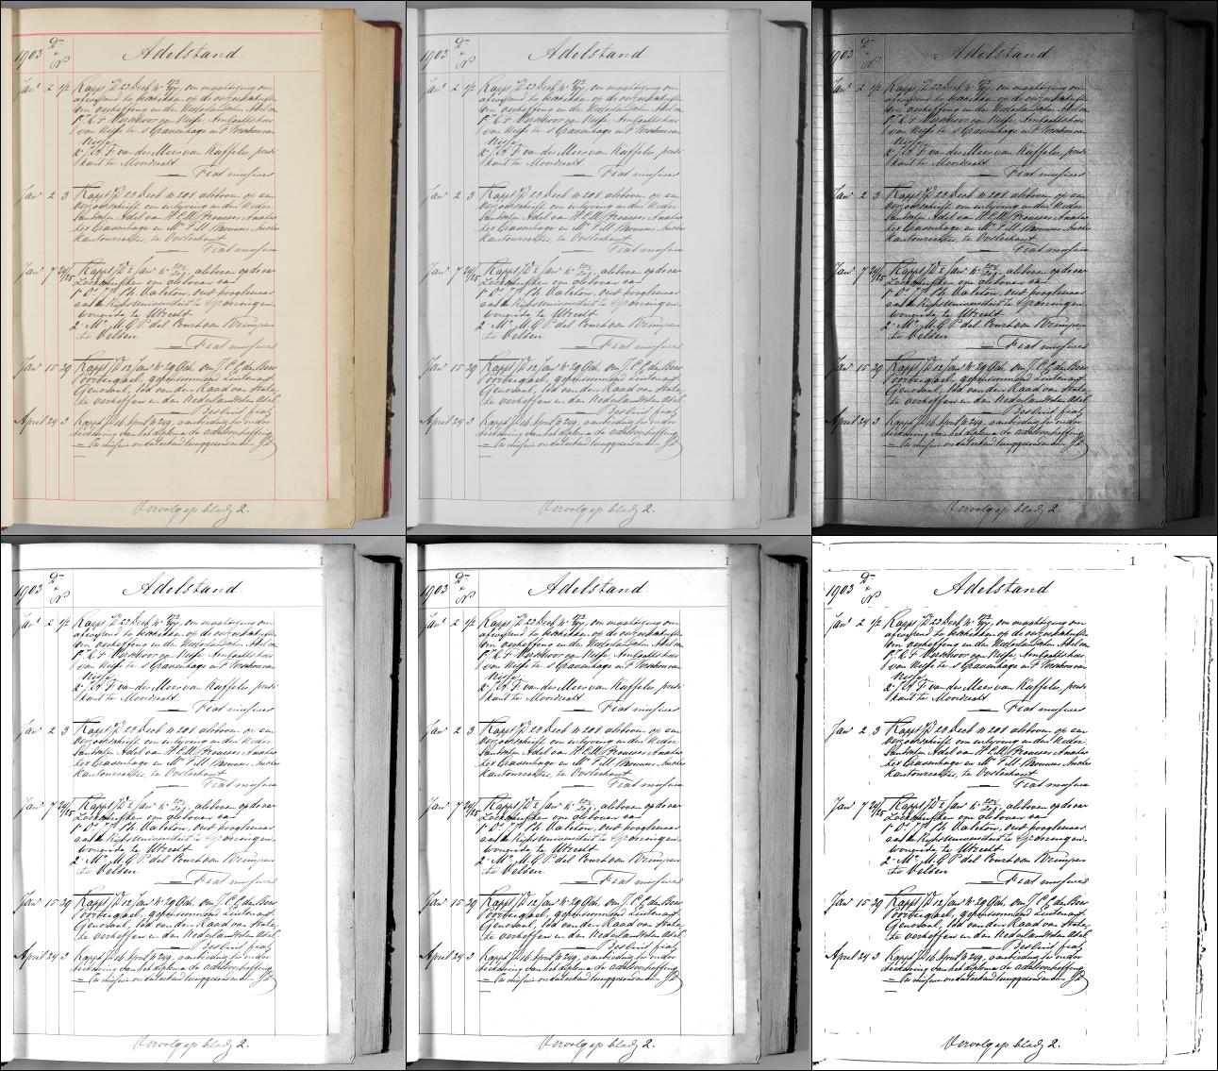
Gray histogram equalized
RGB
Gray
Gray Global contrast enhanced
Gray Local contrast enhanced
Bitonal B/W, dithered

Slide 39
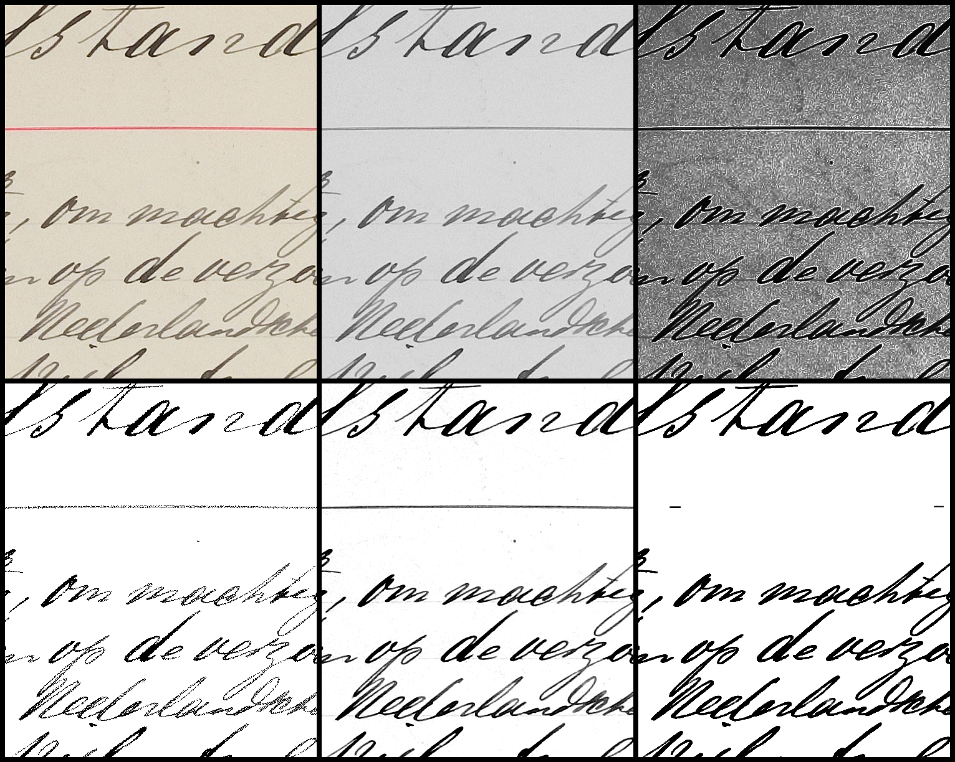

Slide 40
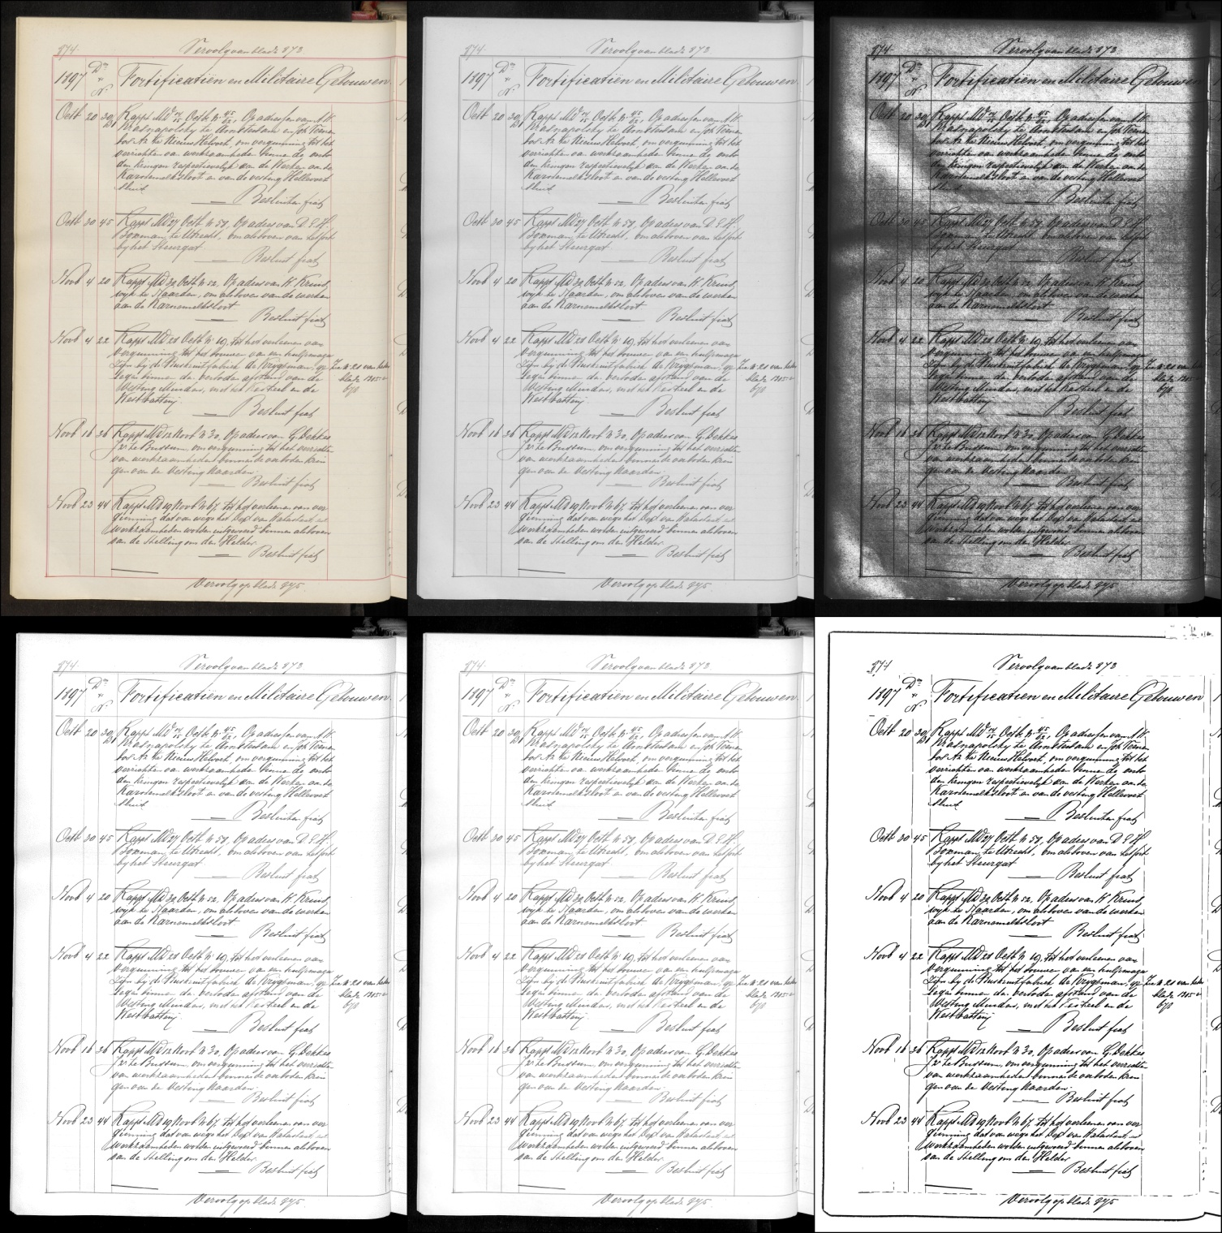

Slide 41
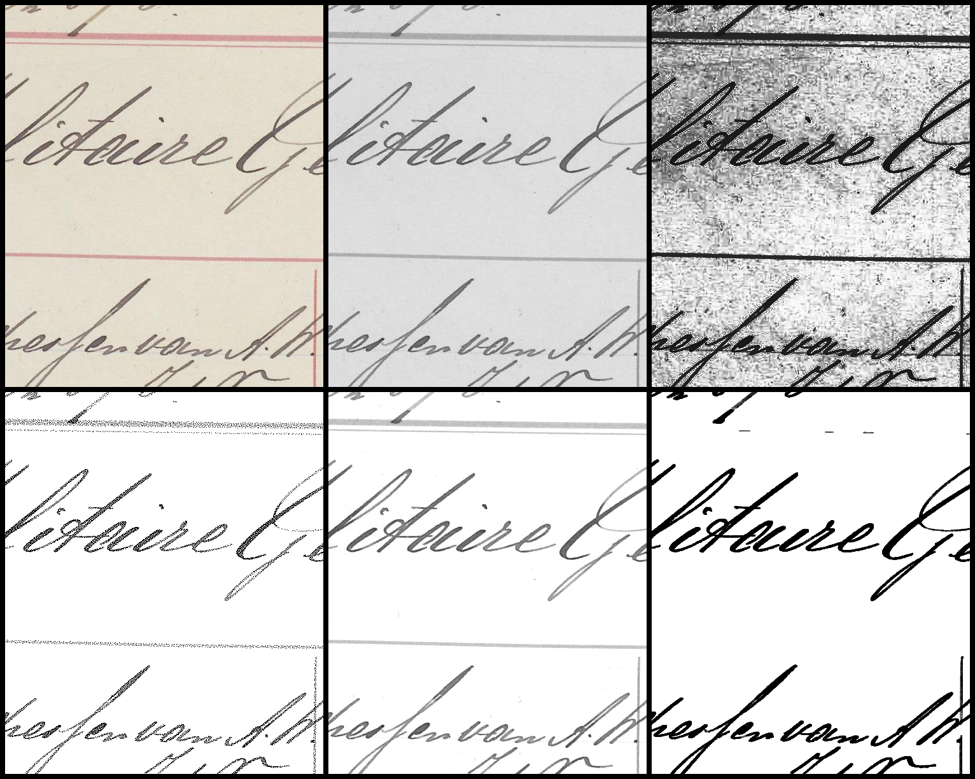

Slide 42
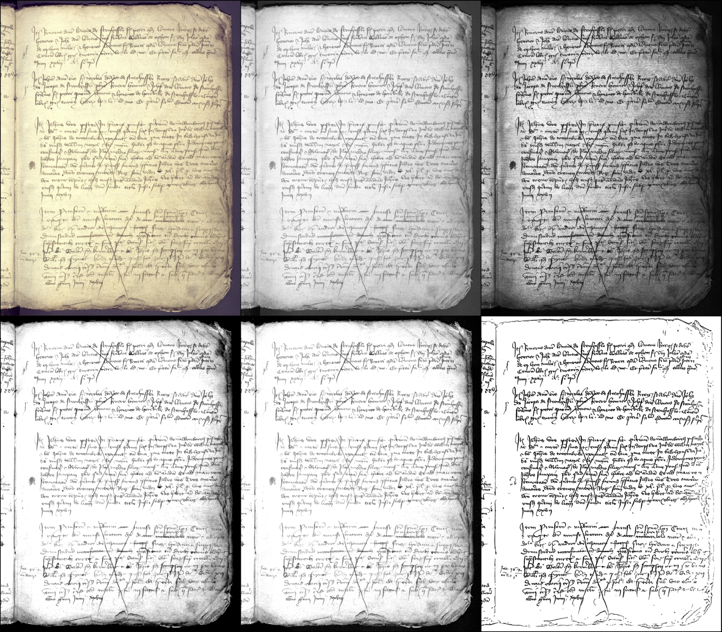
SAL 1421 Company C

Slide 43
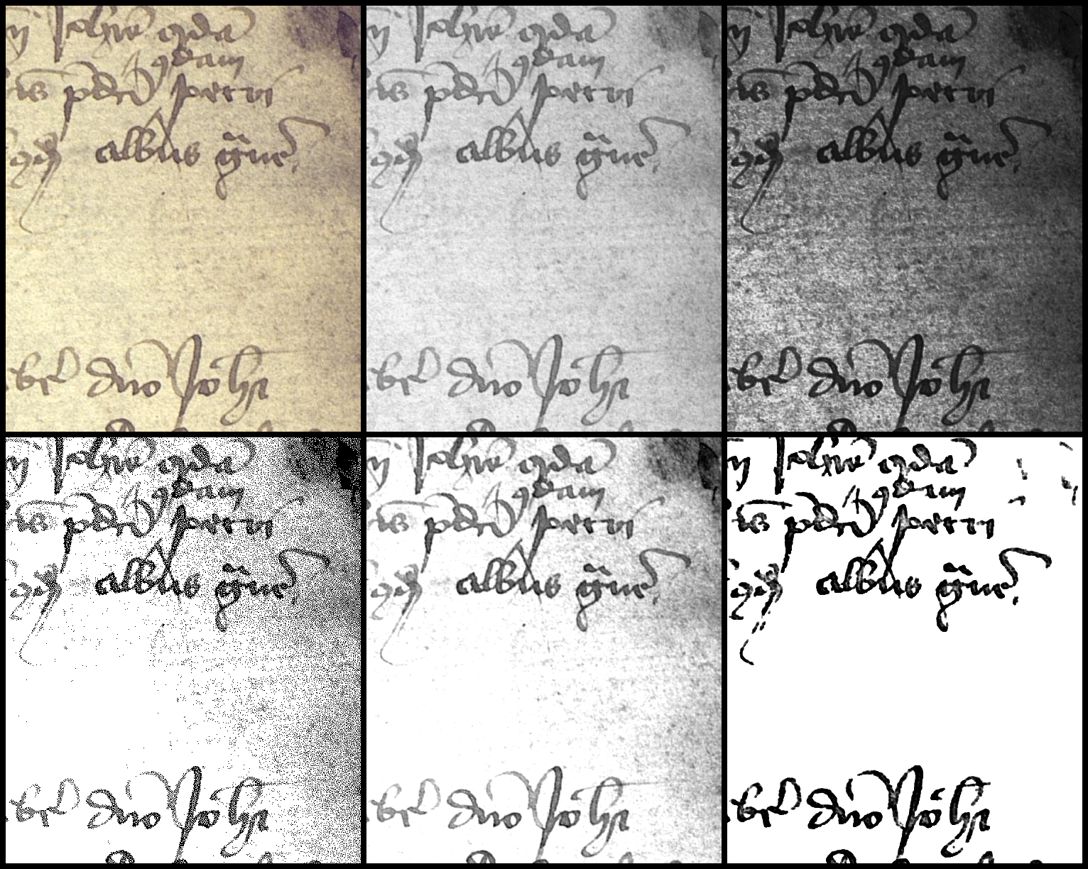
SAL 1421

Slide 44
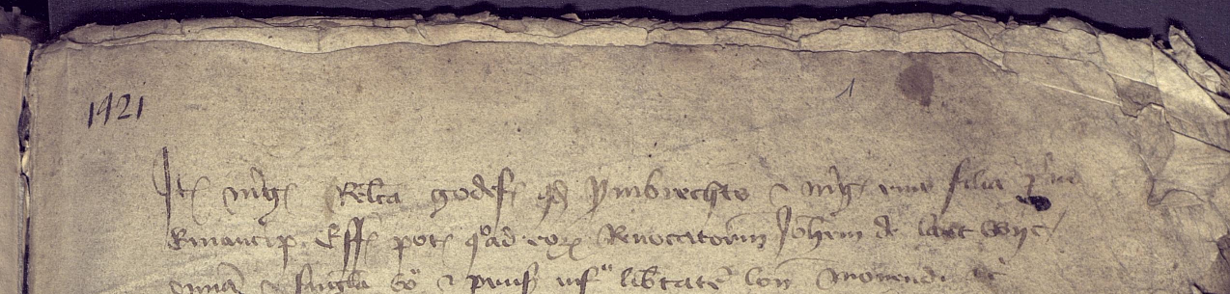
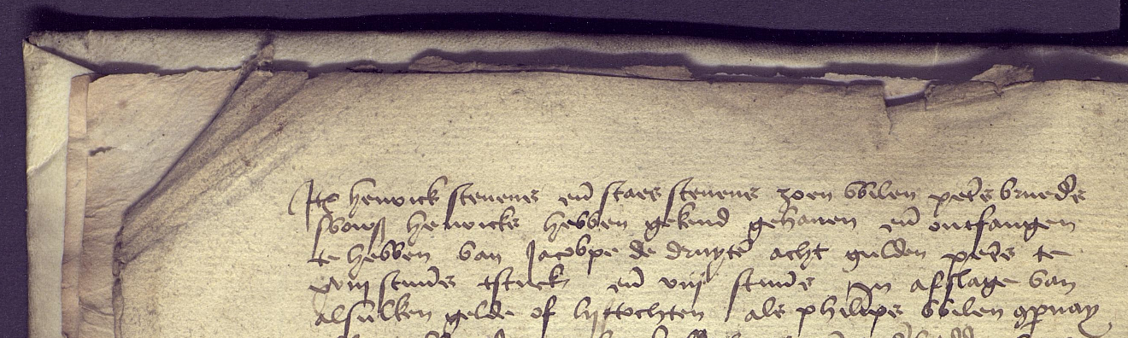
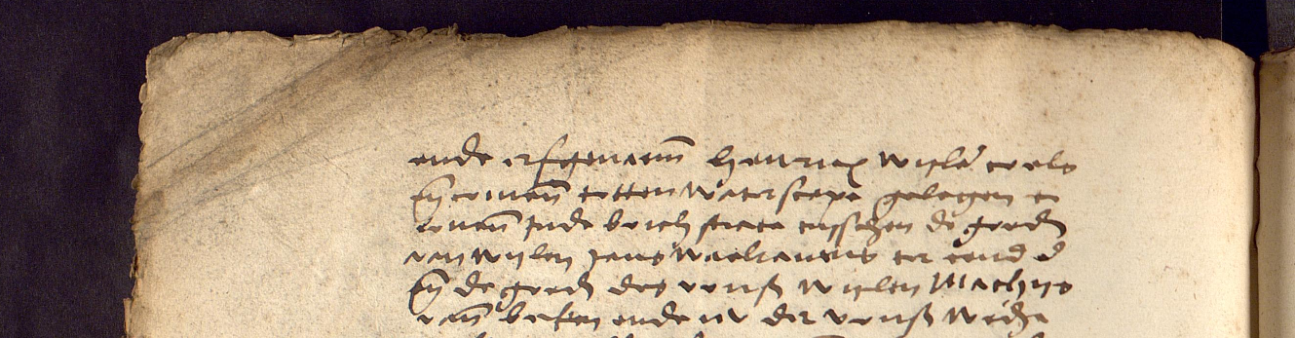
1421
1457
1559

Slide 45
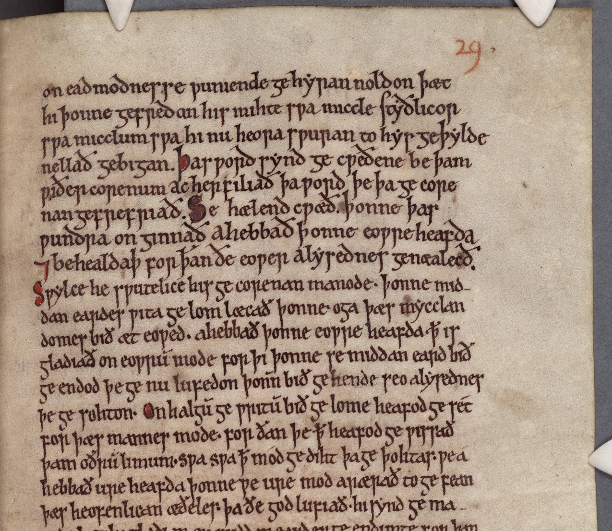
Beowulf
Elaine Treharne
Stanford

Slide 46
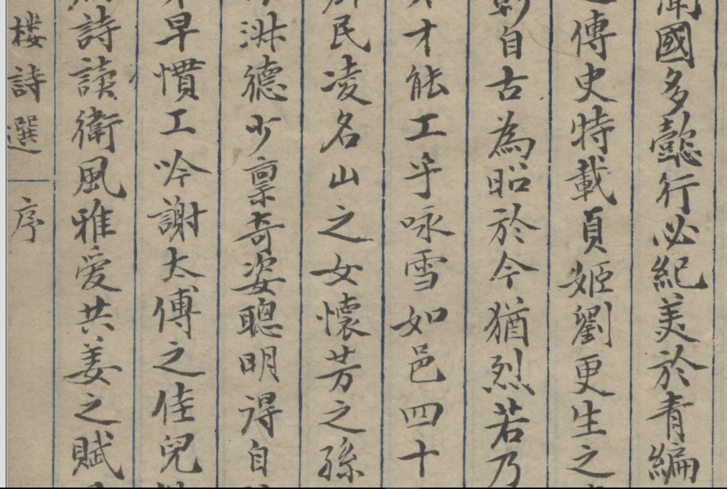

Slide 47
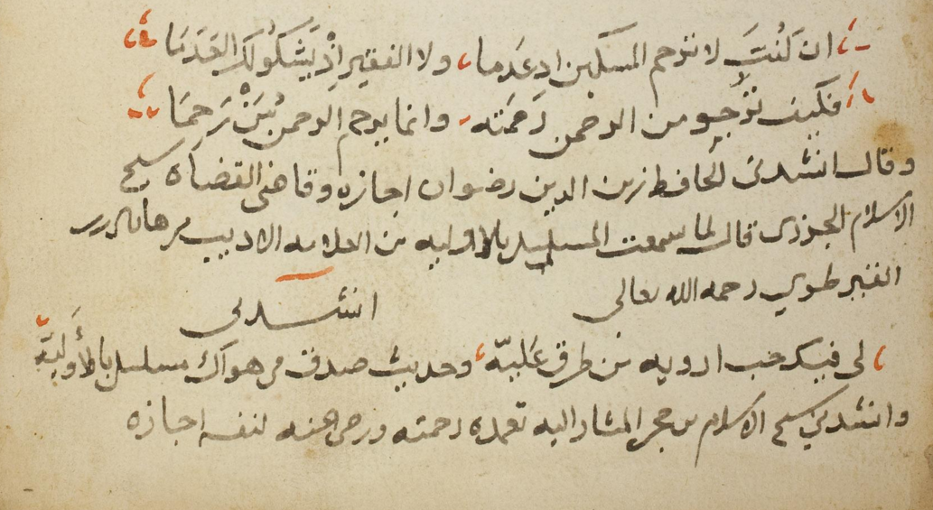

Slide 48
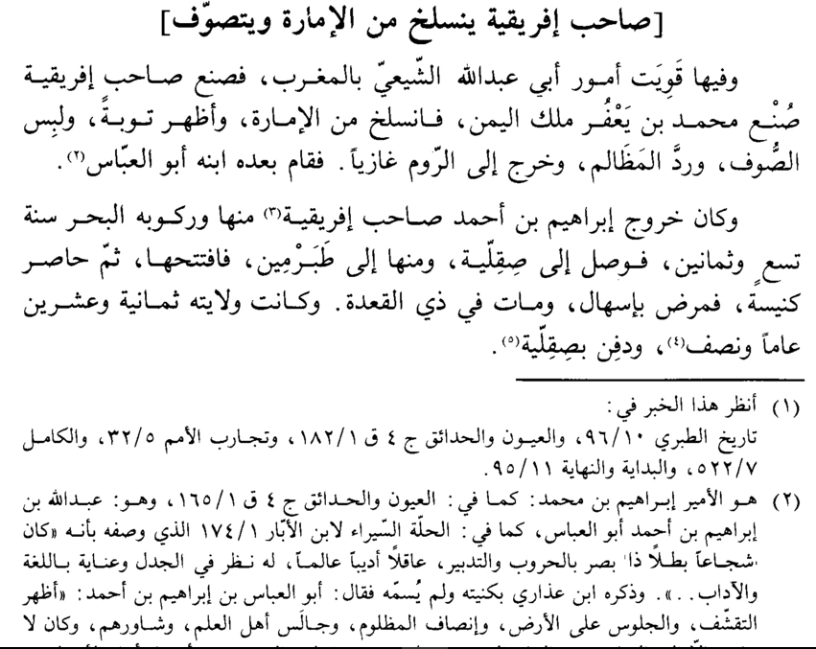

Slide 49
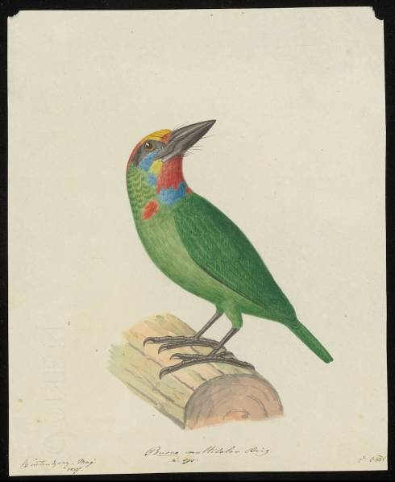

Geolocation and Date
Scientific name of species
Name of field scientist(=artist)
Fig. 4. Field drawing of a red-throated Barbet (Begalaima mystacophanos), Buitenzorg, Java, May 1827. Each field drawing contains place names, dates, scientific names and person names. The NC collections contains ca. 2000 of such field drawings.
NWO/ Making Sense project

Slide 50
Scanning and image preprocessing
‘Simple operations’ such as ink/paper (FG/BG) separation and getting at text-image components are still difficult in image-processing, due to a pervasive ‘chicken and egg’ problem:
“In order to know the text, a system needs a good segmentation, but a perfect segmentation into lines and words is only possible knowing the text “
Also systems that claim to be segmentation free must segment text into lines and deliver ‘blank’ codes for the word separations
Even systems that work with grey scale or color need to decide (yes/no) whether an object under focus is a real text item

Slide 51
Pattern recognition and machine learning
Several years of experimentation)
started in 2005: A label-harvesting observatory
Monk was switched on, to a largely autonomous mode, in 2009
For developing and optimizing two functions:
Retrieval: return images for a given keyword
Recognition: return the most likely word given an image

Slide 52
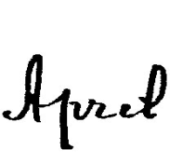

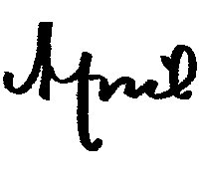





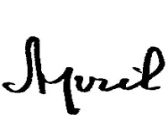
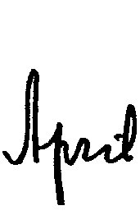
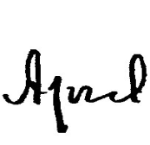
Retrieval of instances,
Shape Feature B rank_{j} (P(X_{j}|Model)
Recognition of classes,
Feature A
argmax_{i} (P(Model_{i}|X))
Rappt Aug April Amsterdam Besluit
Van Oosten & Schomaker (2013) Separability & Prototypicality … J. Pattern Recognition

Slide 53

Boosting performance
Old mine-shaft elevator principle: Fahrkunst
After having trained with method A to its ‘max’
An orthogonal method B can reach a higher performance
Then method A again, etc.
Until the real asymptote is reached
Method A – Method B

Slide 54
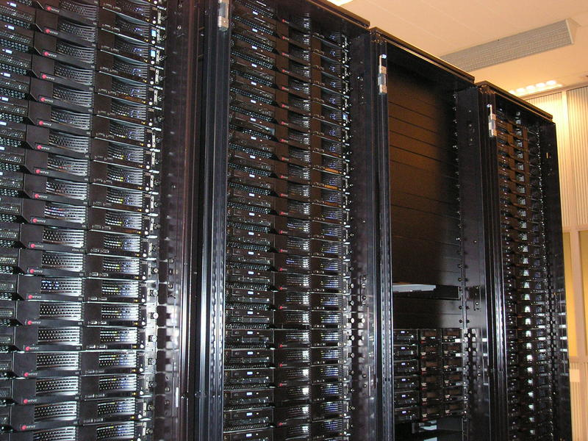
Model refinement
Hit list computation
Labeling by humans
THE SOLUTION: 24/7 learning over internet RuG HPC cluster
“Interactive Supercomputing”

Slide 56
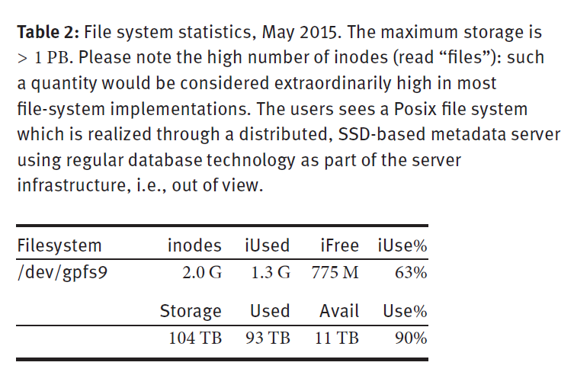
Schomaker, L. (2016). Design considerations for a large-scale image-based text search engine in historical manuscript collections, Information Technology. 59, ISSN: 2196-7032
Maximum number of files
Current number of files

Slide 57
Lessons learned during Monk development
A shape feature which is powerful for Retrieval may not be strong in Recognition!
Feature B: hit list should provide nice, intuitive ranking in a satisfying ‘hit list’
Feature A: target word class should survive competition with the other word classes (emerging needle from the heterogeneous hay stack)

Slide 58
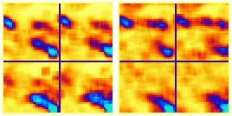
Examples of feature patterns for two words
van der Zant. Schomaker, Haak (2008). IEEE PAMI
Bag of visual words (BOW), 9x9pix at 150dpi, 33x33
Four quadrants,
Max pooling
Amsterdam Groningen

Slide 59
for nearest-neighbour matching

Slide 60
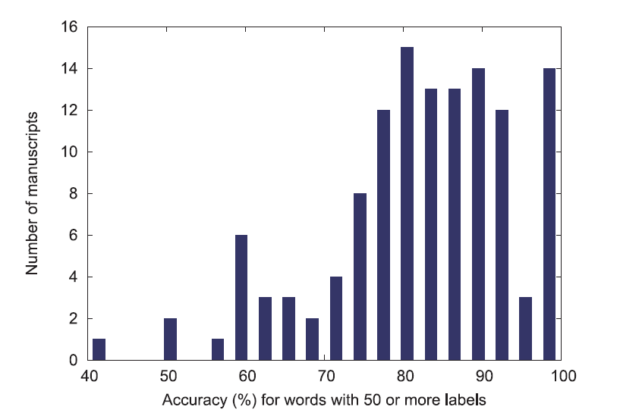

Slide 61
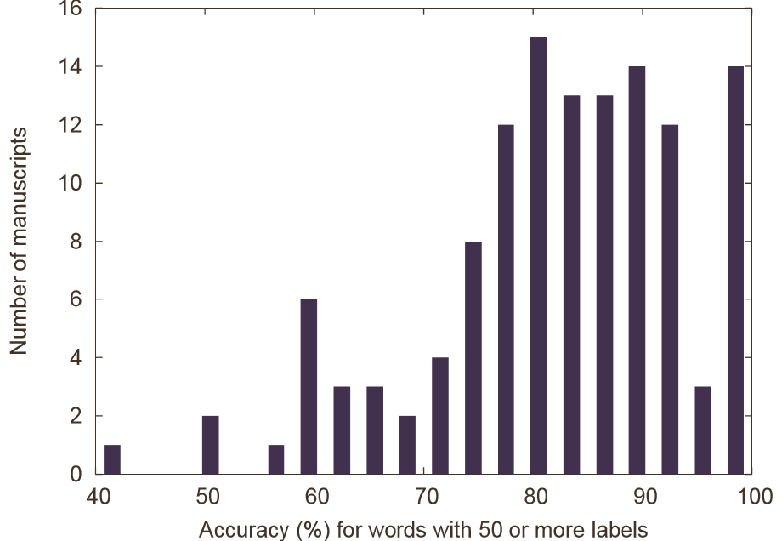
Performance
126 manuscripts
Train: 25 words/class
Test: 25 words/class
Additional labeling

Slide 62
Other Recognizers Used
HMM (hidden Markov models)
We wanted to expose weaknesses of HMMs
Deep learning/convolutional, full-word
CNNs + attribute learning
CNN/LSTM/CTC approaches
CNN/embeddings → transformers
All methods have particular & clear disadvantages, also the newest deep learning algorithms!
Sparse labels? Continuous changes in data? Hundreds of millions (!) of images?

Slide 63
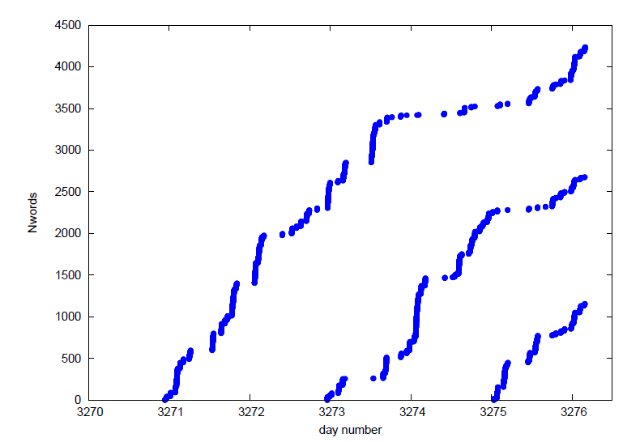
Label harvest: ‘HUMAN-confirmed’
Jumps in the number of harvested word labels (y-axis) coincide with reaching a critical training dataset size (time axis)
Note the stepwise ‘snowball effects’
New Naturalis collection, first three document sets, March 30 to April 6, 2016 (NWO/Making Sense project)

Slide 64
Performance
Retrieval precision increases monotonously with number of word examples
Lexicon of 11k words: > 81% recognition rate, KdK
Lexwords with 50+ examples: > 95% correct
Idem, Cliwoc captain’s logs: 93%
#training examples | What to expect in Top 50
1 | Correct instance is good luck
5 | A few correct hits
20 | Many useful hits

Slide 65
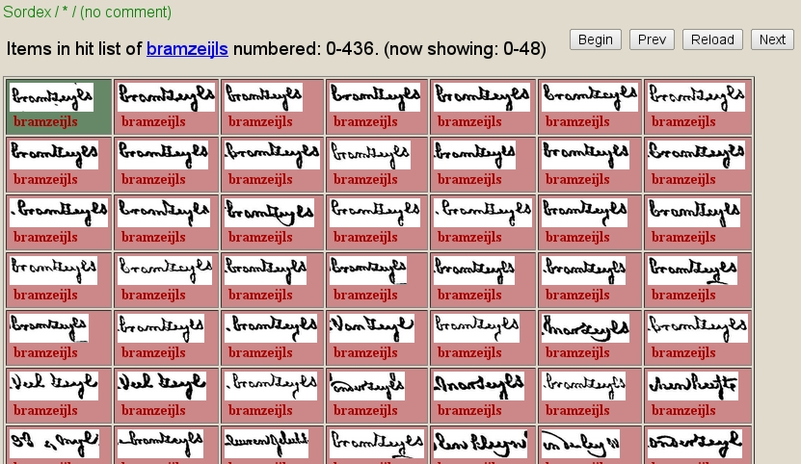
Good results: bramzeijls (top gallant’s) hit list after training on just 2 examples

Slide 66
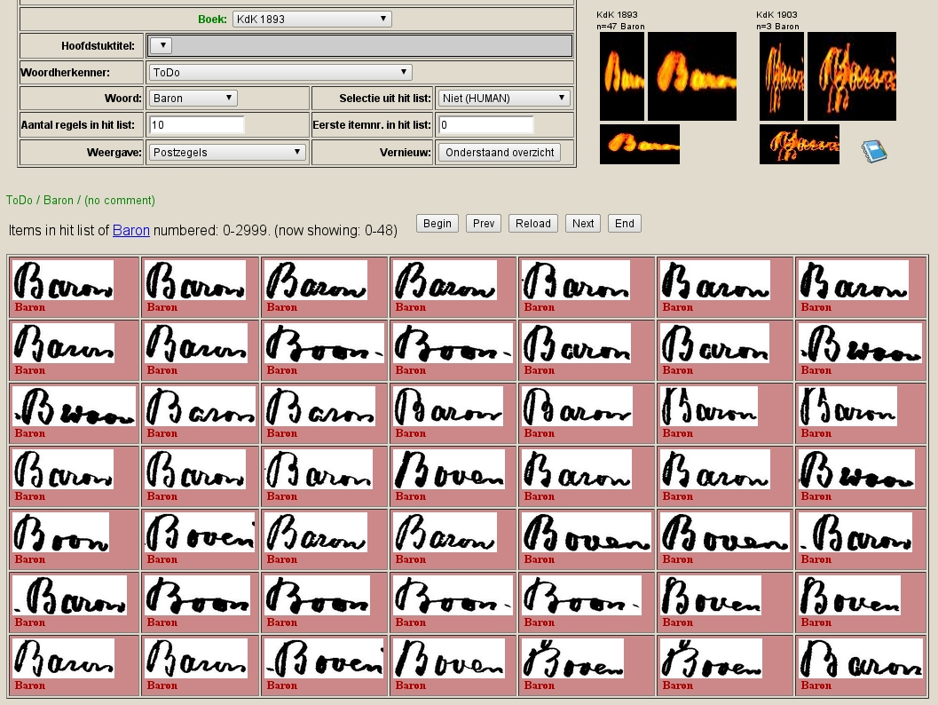

Slide 67
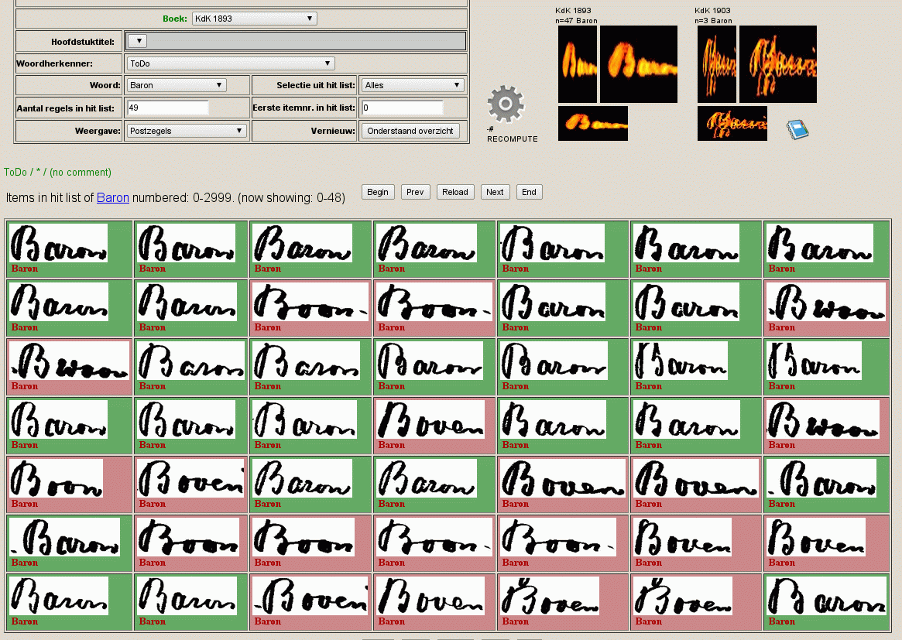

Slide 68
Qumran scrolls: 2400 photographs
Using Monk for character labeling
With Daniel Stoekl and Mladen Popovics
Using its 24/7 machine-learning cycle:
Label ➔ Train ➔ Label some More ➔ Train ➔ Easily label Many
Thousands of characters ‘mined’ out of the Qumran collection of photographs in just two weeks, with very little effort in human labeling

Slide 69
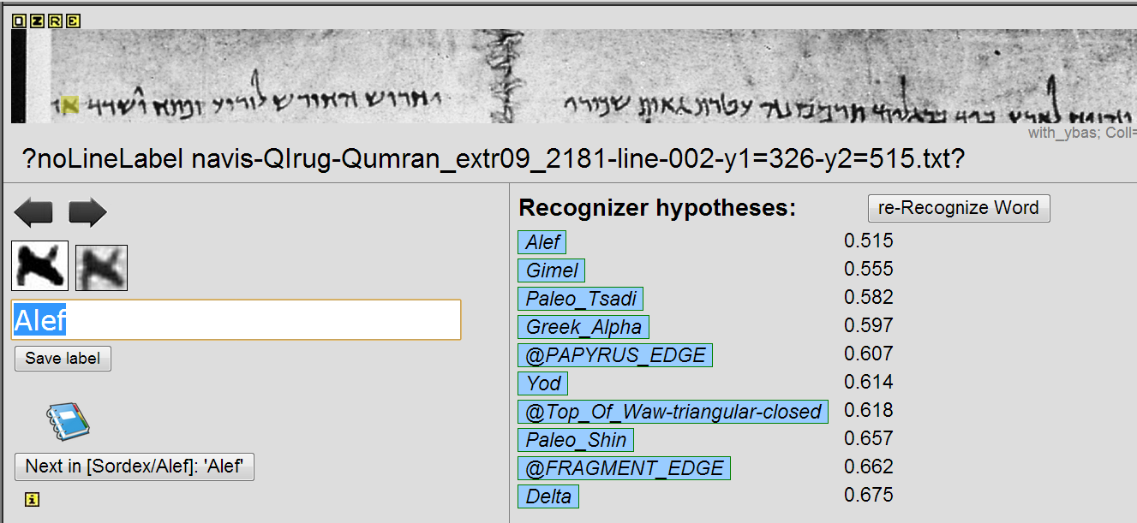

Slide 70
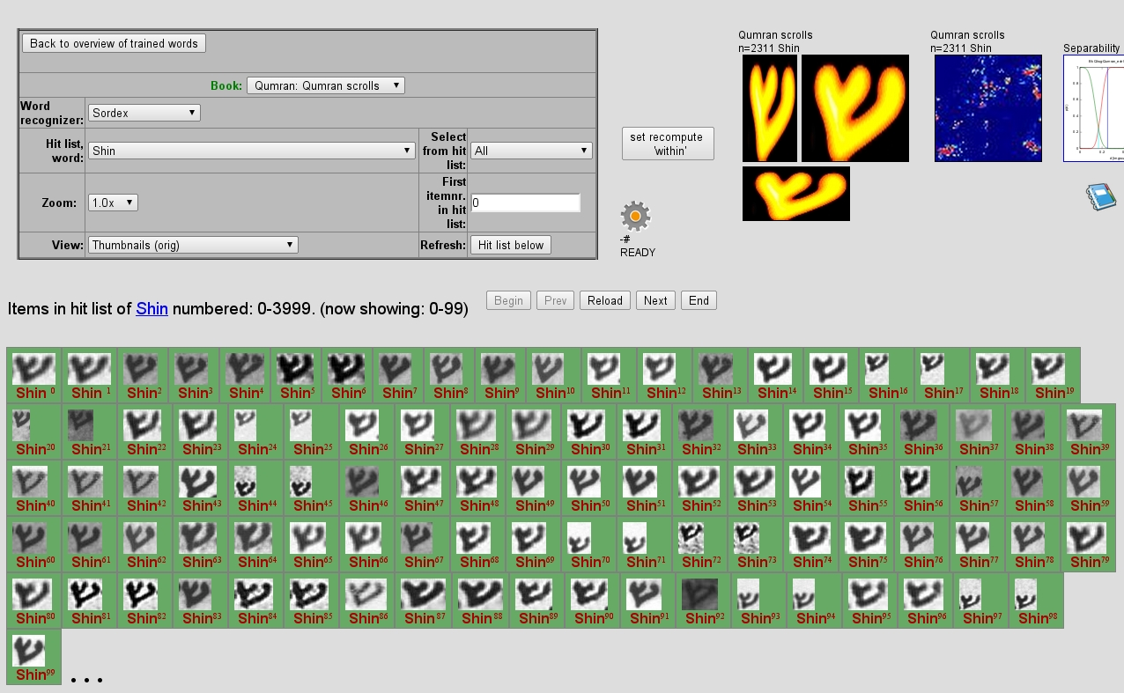

Slide 71
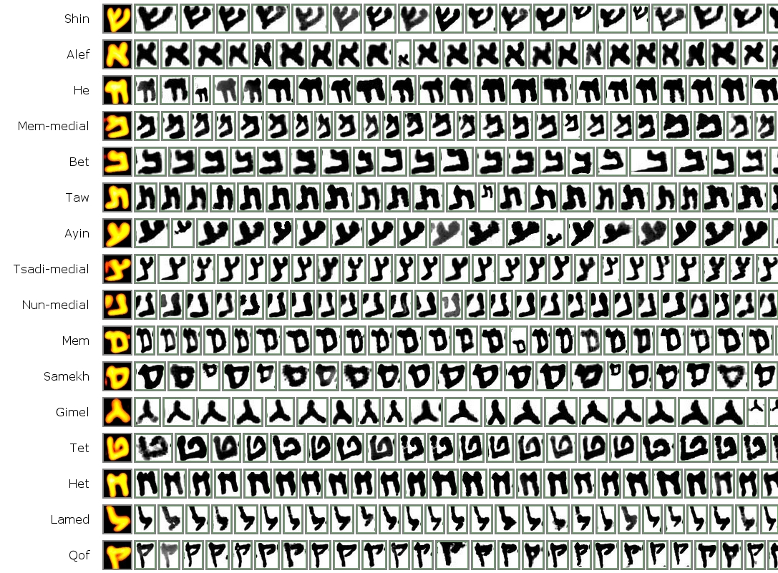

Slide 72

Yes, also Chinese characters (handwritten & woodblock, Grace Fong & Harvard Yenchin collection)

Slide 73

Static index example: Chronicon Boemorum (1201 AD, Cosmas)

Slide 74

Monk’s Blue Book (xml): @Monk-code is a handle for several interpretations or (unicode) renderings. We will also implement MUFI here.
Medieval Unicode Font Initiative

Slide 75



Annotation / transcription formats
TEI: aimed at transcription, limited functionality for layout specification
(TruViz, GEDI, Alto) ➔ ‘PAGE’ standards for layout specification limited functionality for transcription/transliteration and encoding (Pletschacher, 2010)
(x₁,y₁, x₂,y₂, …, x_{n},y_{n})
Polygonal ROI

Slide 76
Methods in Monk
Monk
High-performance Linux e-Science environment: 900TB/28 core/126GB + etc., new infrastructure as of June 2018
Image (pre)processing
Layout analysis and segmentation (fragments, paragraphs, lines, words)
Pattern recognition / shape analysis
Feature based (e.g.: ‘Hinge’)
Trained-feature based (e.g.: ‘Bag of visual Words)
Neural networks / Deep learning (CNN, LSTM)

Slide 77
Deep learning neural networks
Monk
Impressive results in many application domains
Not so new (~1990) but only effective since ~2005 thanks to:
Increased computing power;
Larger, massive, labeled data sets & benchmarks;
Improvements within training algorithms.

Slide 78


Handwriting recognition research had a huge impact on the development of deep learning. 2D Convolutions, saving weights: CNNs!
Yann LeCun/Int. Workshop on Frontiers in Handwriting Recognition April 2-3, 1990 Montreal
Deep convolutional networks

Slide 79



Slide 80
Deep learning / Recent advances in ML
Monk
Self-driving cars
Predicting internet user interests (using ‘cookies’)
Twitter-based epidemiology (‘flu tweets’)
Create a van Gogh or Munch version of a photograph
Coloring of old black and white movies
Learning to play Atari Breakout, Pacman etc.
AlphaGOzero: computer wins at playing GO
etc.
Most of the successes are based on neural networks

Slide 81

Yolo (you only look once) Joseph Redmon (2015)

Slide 82

Yolo improvements (Karol Majek)

Slide 83
Handwriting recognition problems
What? (is written?)
Many languages, scripts
Over historical periods
Contractions of letters
‘Suggested’ sloppy letter shapes
Individual writer styles
Image problems
➔ Easy low-hanging fruit for deep learning?

Slide 84
But it is not easy! Requirements for deep learning to be successful
Enough computing power (NVIDIA GPU)
Skillful PhD student(s)
Massive labeled data!
Limited number of classes (often < 100)
Minimally 100 examples per class in training
ImageNet ILSVRC: 1000 classes, 1M bounding boxes Historical performance: 2011: 75%, 2012: 84%, 2017: 95%, …
Transkribus/Read project: training set is 70-100 transcribed pages for a new book or style

Slide 85

Don’t scorn distance-based methods!

Slide 86
What about deep learning for script recognition in historical collections?
A freshly scanned Chinese historical collection may have characters from 106,000 classes (ytizi zidian)
Of which the majority has no, or just one example for training
If hidden Layer N-1 has 1000 units, 100k classes imply 1000 x 100,000 = 100M coefficients (weights) in the last network layer alone!

Slide 87
A CNN for the complete Chinese character set?
Verdict: Not feasible in this manner.
~1 billion examples would be needed

Slide 88
Attribute classification
Attributes: Nameable, symbolic characteristics for objects of interest (furry, four-legged, tail, whiskers, ascender/descender, cusp, crossing, CAPITAL)
Attributes are not features: They have a symbolic meaning in the application domain, whereas features are low-level shape characteristics, directly computed from the image
If attributes can be automatically derived from class name and a set of rules, they are ‘cheaper’ than human labeling
Many attributes N is good: covered #classes C can be high, e.g., C = 2^{N} for binary attributes. Theoretically: N=17 for Chinese.

Slide 89
Solutions for large lexicon or out-of-set problems

Slide 90
Solutions for large lexicon or out-of-set problems (1)
Classification is:
Find Nearest Neighbor in attribute space
(Sheng He &
L. Schomaker, submitted)
HDBW1.1 94.7%, 3755 classes

Slide 91
Solutions for large lexicon or out-of-set problems (2)
Classification is: Find Nearest Neighbor in hidden activation patterns/embeddings (Chanda, Schomaker et al.,2018) 85-90%

Slide 92
Zero-shot / Single-shot / Few-shot learning using a pretrained network and tapped features
Zero-shot: an unseen pattern is presented and can be classified uniquely on the basis of an understandable (symbolic) attribute pattern
Single-shot: one example is used to model a class
Few-shot learning: several examples for a class exist such that a simple model (mean vector) can be computed

Slide 93



Example: finding DATE blocks in handwritten manuscripts
Zhenwei Shi (2016)

Slide 94
Best of three worlds!
Deep learning for powerful shape descriptors NN
Nearest neighbor (or nearest mean) PR
Attributes gofAI

Slide 95

Part II – other uses of deep learning?
Image processing: still not ‘solved’
Binarization: ink vs paper pixels
Use deep learning for repainting the pixels of an input image
➔ on the Dead Sea Scrolls
Leon Gatys Tuebingen (2015)

Slide 96







Deep learning for binarizing of DSS fragments

Slide 97
Deep learning for binarizing of DSS fragments
Maruf Dhali (PhD)
Also here, labeling is needed for training
Scholars used ‘Gimp’, for masking ink pixels as ‘ink’, from group of M. Popovic
Full plates are labeled (see? monks!)

Slide 98




Input
Repainted
Target

Slide 99
Improved curvilinear line segmentation (Sukalpa Chanda)

Slide 100
At this point
Word-based image classification and word spotting work!
Method choice: depends on Ntraining_samples/class 1NN → kNN → SVM → MLP → CNN → … n=1, n>5, n>20, n>100, n>1000 “ball-park principle”
But:
whole-word image requires (over)segmentation first, into word candidates
Shape information at letter or syllable level cannot be reused/exploited: at least 1 example/word needed
Cannot do the Out-of-Vocabulary (OOV) task!

